Slide 1
STAT 50
Section 2.2 2/08/2021
1 of 2

Slide 2

































































Slide 3






















Slide 4


























Slide 5







Slide 6























Slide 7
























Slide 8





















Slide 9























Slide 10
















Slide 11




























Slide 12





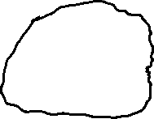




















Slide 13
























Slide 14


































Slide 15




































